Slide 1


Developing Your
Selling Machine

Slide 2


Slide 3
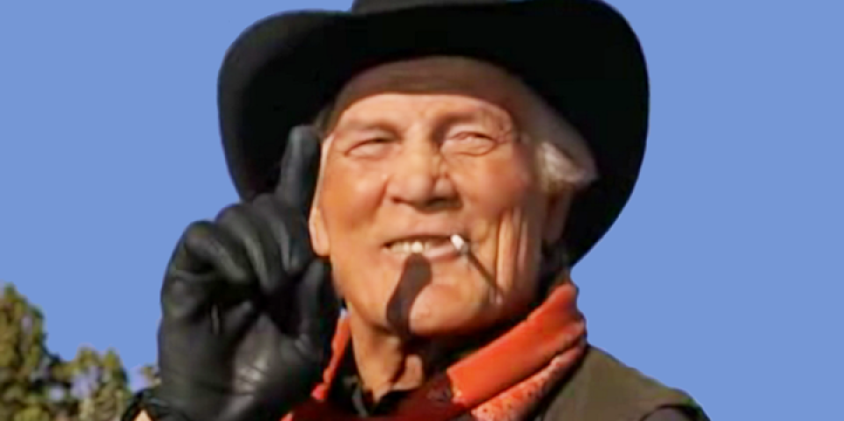

Slide 4
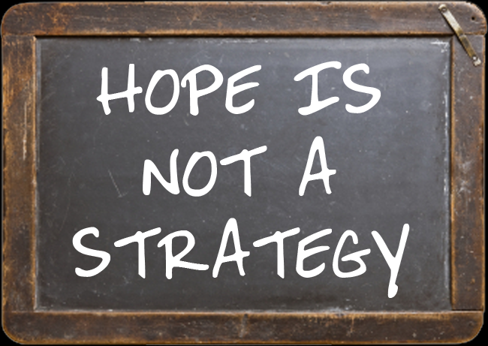

Slide 5
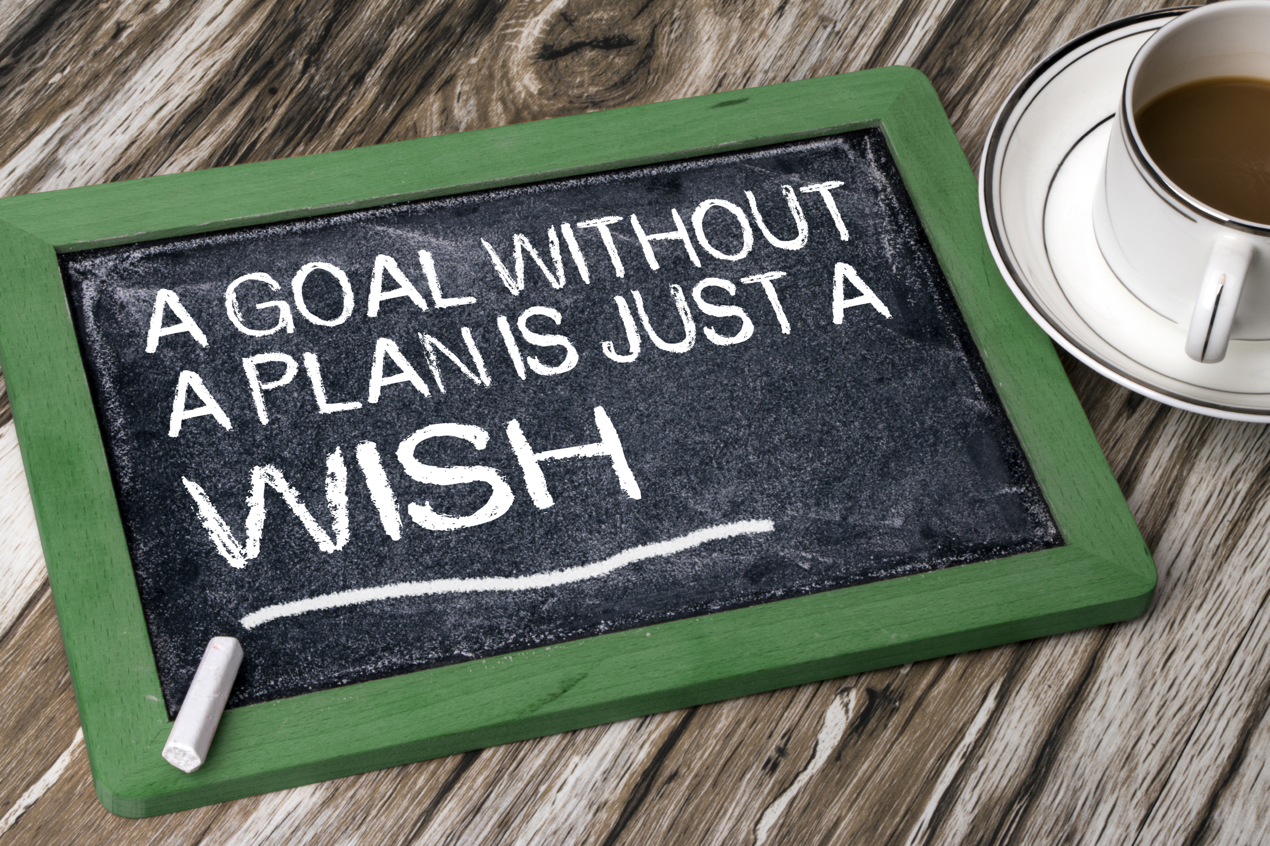

Slide 6


Slide 7
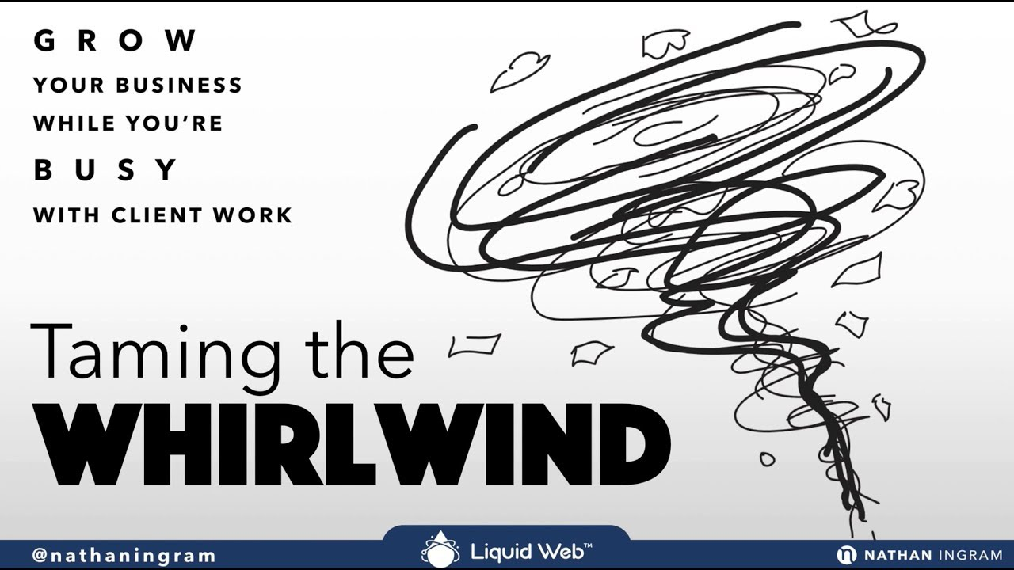

Slide 8

3 Key Elements to an Effective Sales Strategy
Develop a numbers-based plan
Activity and behavior-based selling
Measure, share, report and improve

Slide 9

What is your sales goal this year?
How many sales do you need to make to achieve #1 above?
How many proposals do you need to deliver to achieve #2 above?
How many new prospects do you need to meet to achieve #3 above?
How many new people do you need to interact with to achieve #4 above?

Slide 10
It’s all about day-to-day, week-to-week activities and behaviors
If you and your people could do only 2 things day in and day out, week in and week out, that will lead to you achieving your sales numbers, what would those 2 things be?
Think about activities and behaviors

Slide 11
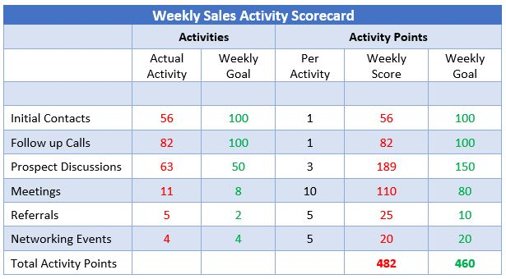

Slide 12

Get Your Team Involved & Engaged
What are the 3-5 metrics you’ll report on and share with your team that will keep them motivated, involved and engaged?

Slide 13
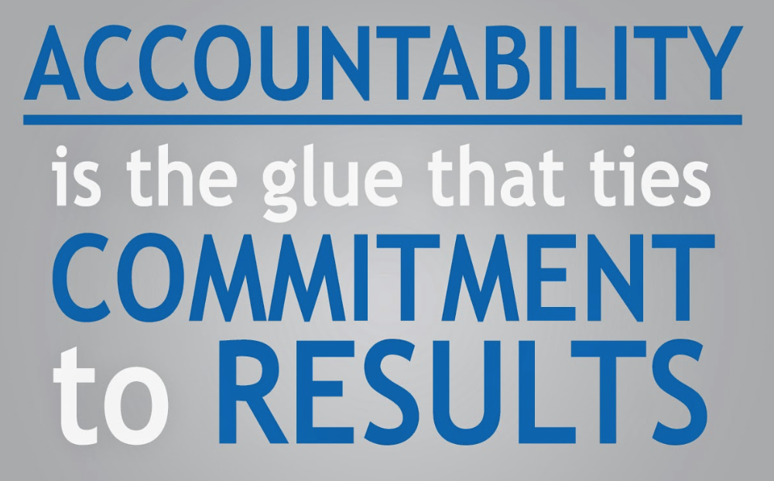

Slide 14
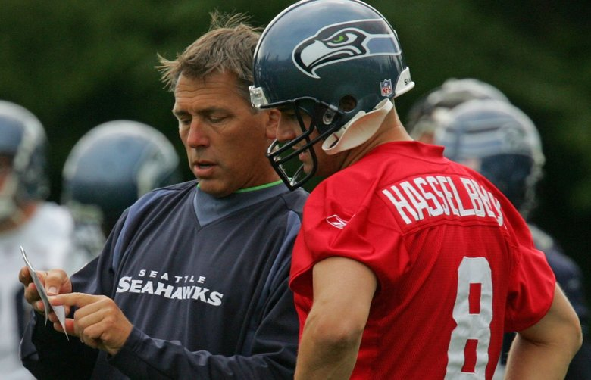

Slide 15
8 Steps to Sales Success
Set your goal and know your numbers – be realistically aggressive
Clarify your target market - decide who your target customers are
Lead toward activities - Identify the 3-5 weekly activities and behaviors
Give your people tools - create sales scripts and talking points
Overcome objections – create talking points to handle the objections
Visual scorecard – keep the team aware of how the team is doing
Cadence of accountability – this is serious, people need to execute
Coach relentlessly – people want to improve, help them improve

Slide 16

Close 100% of Your Proposals – Sales Training
Event
Monday, November 4th – 9am to 430pm
Mississauga, Ontario
What you’ll learn…
What buyers value and don’t value from salespeople
How to be viewed by your prospect as a trusted advisor
3 things you can do to keep control of the sales process
5 elements to determine if your prospect is qualified
Building value, ZOPA and other effective sales strategies
$290 USD per person – includes lunch and book
(Registration deadline is October 11th)

Slide 17

“It’s not how hard you can get hit, but how hard you can get hit and get back up.”
Rocky Balboa
Win
Give your people the proper tools

